Slide 1

AUGMENTED REALITY SETUP WITH MOBILE PHONES FOR REALTIME
APARAJIT K R(2016103505)
SASHANK S(2016103060)
HARINAARAAYAN S(2016103029)

Slide 2
INTRODUCTION
“If you change the way you look at things, the things you look at change.”
Augmented reality is changing the way we view the world -- or at least the way its users see the world. Picture yourself walking or driving down the street. With augmented-reality displays, which will eventually look much like a normal pair of glasses, informative graphics will appear in your field of view, and audio will coincide with whatever you see. These enhancements will be refreshed continually to reflect the movements of your head.

Slide 3
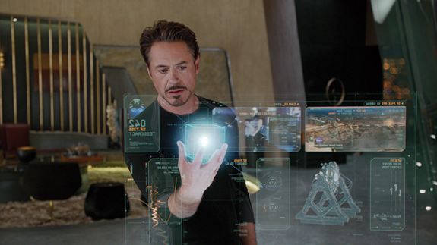
AIM
To detect and recognize objects in an image. We use reverse image search and vision API to determine the object and use text to speech to describe it.

Slide 4
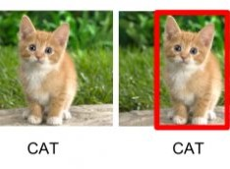
OBJECT RECOGNITION
Object recognition is a computer vision technique for identifying objects in images or videos. Object recognition is a key output of deep learning and machine learning algorithms. When humans look at a photograph or watch a video, we can readily spot people, objects, scenes, and visual details.

Slide 5
OUR PLATFORM
We usually think of Unity as a game engine, a collection of tools for making video games; we all know it’s good at doing that job. But, its use shouldn’t be exclusive to making games, there are many other uses for Unity. Unity is a powerful multimedia tool capable of deploying to nearly every modern platform out there.
Thus we have used it to make an app which is more of an helpful tool rather than a game.
We can import animations to make our projects visually attractive.

Slide 6

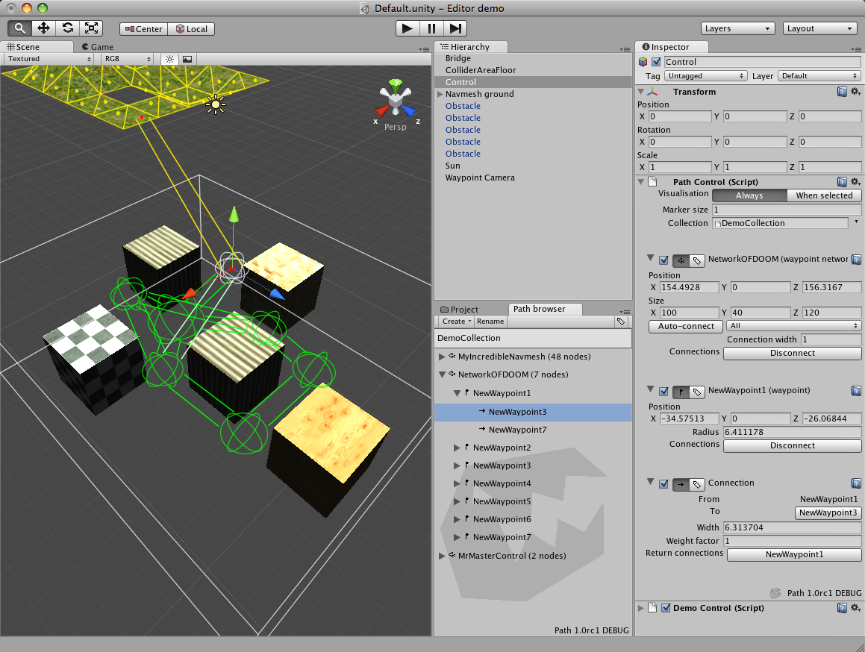
BASIC OUTLOOK OF UNITY

Slide 7
What we use?
REVERSE IMAGE SEARCH:
Google Reverse Search lets you search by images instead of keywords. Upload a picture from your desktop, tablet or mobile phone, and Google will show all the other web pages on the Internet that have similar images.
The images are hosted anonymously on the Internet and cannot be discovered by other users.

Slide 8
TEXT TO SPEECH:
Text-to-Speech (TTS) refers to the ability of computers to read text aloud. A TTS Engine converts written text to a phonemic representation, then converts the phonemic representation to waveforms that can be output as sound. TTS engines with different languages, dialects and specialized vocabularies are available through third-party publishers

Slide 9
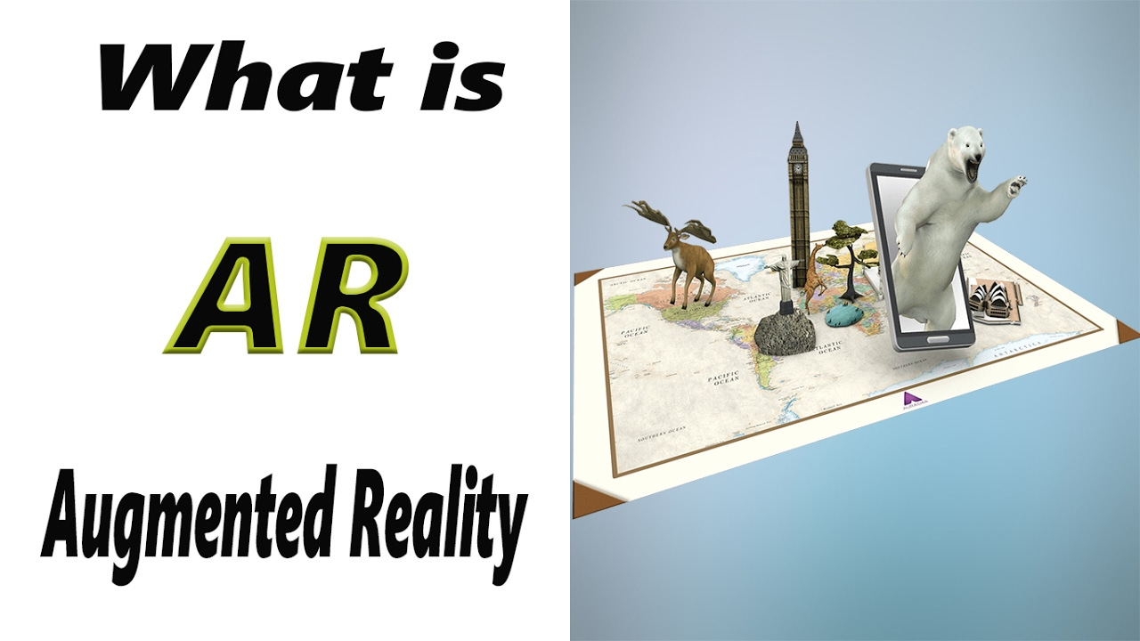

Slide 10
IMAGE TARGETS-VUFORIA
Image Targets represent images that the Vuforia SDK can detect and track.
Image Targets do not need special black and white regions or codes to be recognized.
The SDK detects and tracks the features that are naturally found in the image itself by comparing these natural features against a known target resource database.
Once the Image Target is detected, the SDK will track the image as long as it is at least partially in the camera’s field of view.

Slide 11
USER-DEFINED TARGETS-VUFORIA
User-defined targets are Image Targets that are created at runtime from camera frames selected by the user.
They share most of the capabilities of a standard Image Target with the exception that they do not support Virtual Buttons.
User Defined Targets should be captured and viewed under moderately bright and diffuse lighting. The surfaces of the object should be evenly lit. Indoor scenarios generally work well.

Slide 12
STEPS TO BE FOLLOWED
Select the object for which marker has to be generated
Detailed image
No repetitive patterns
Frame the image
Scan target
Build target
Add target to database

Slide 13
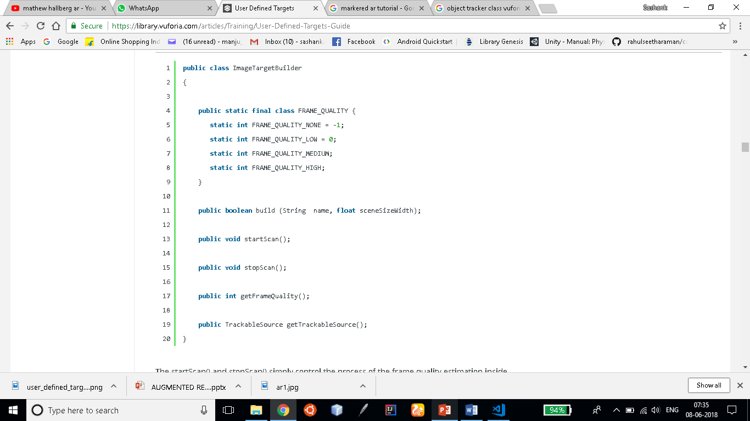
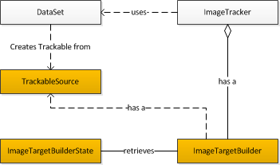

Slide 14
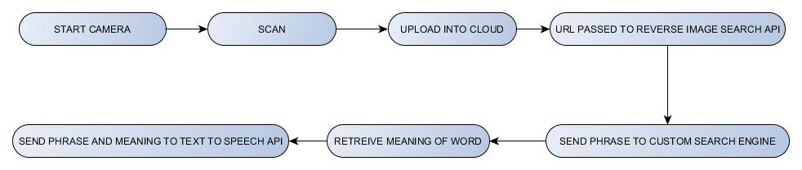
WORKFLOW

Slide 15
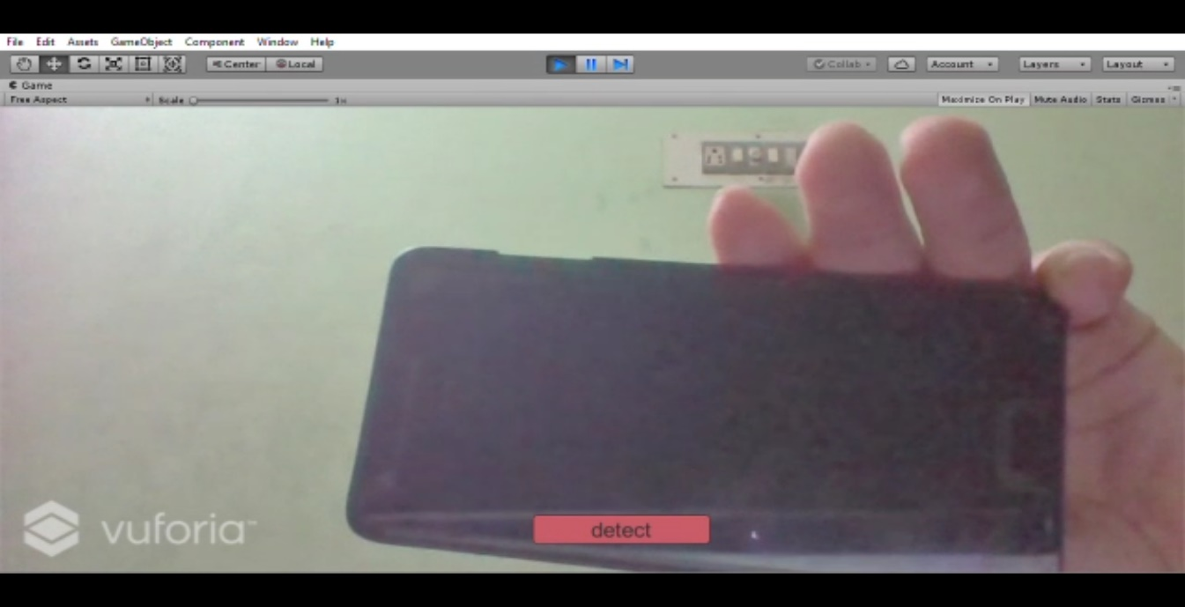
STEPS
1.TAKE PICTURE
2.SEND IMAGE TO CLOUD
Cloudinary service is essential as the further proper functioning of the project requires image URL
Google Reverse search works only with Image Urls and not with image files

Slide 16
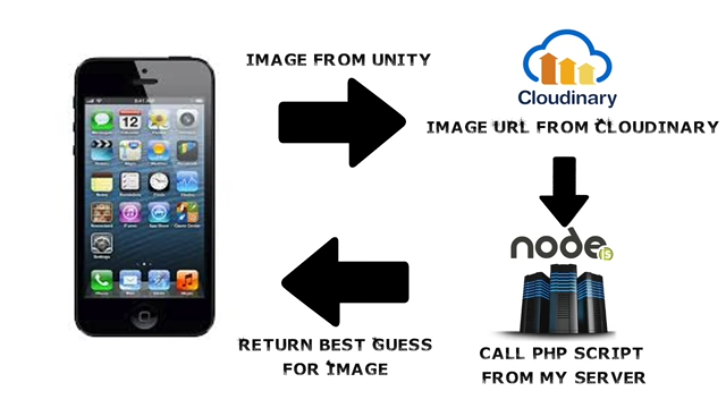
3.SENDING CLOUD URL TO GOOGLE REVERSE IMAGE SEARCH API:

Slide 17
`
USING APIs TO GET THE DESIRED RESULT
Send the word or phrase to Google Custom Search Engine to find the Wikipedia links such that we can find its appropriate definition and pass it to the app and in case if we can’t find those Wikipedia links the word or phrase is sent to Oxford dictionary API .

Slide 18
FEATURES OF THE APP
The word appears on the focused object using augmented reality and the definition is spelt out.
The three colors on top of the app indicate the quality of the background in which the image is taken.
It is advisable that the background should be of high quality.

Slide 19

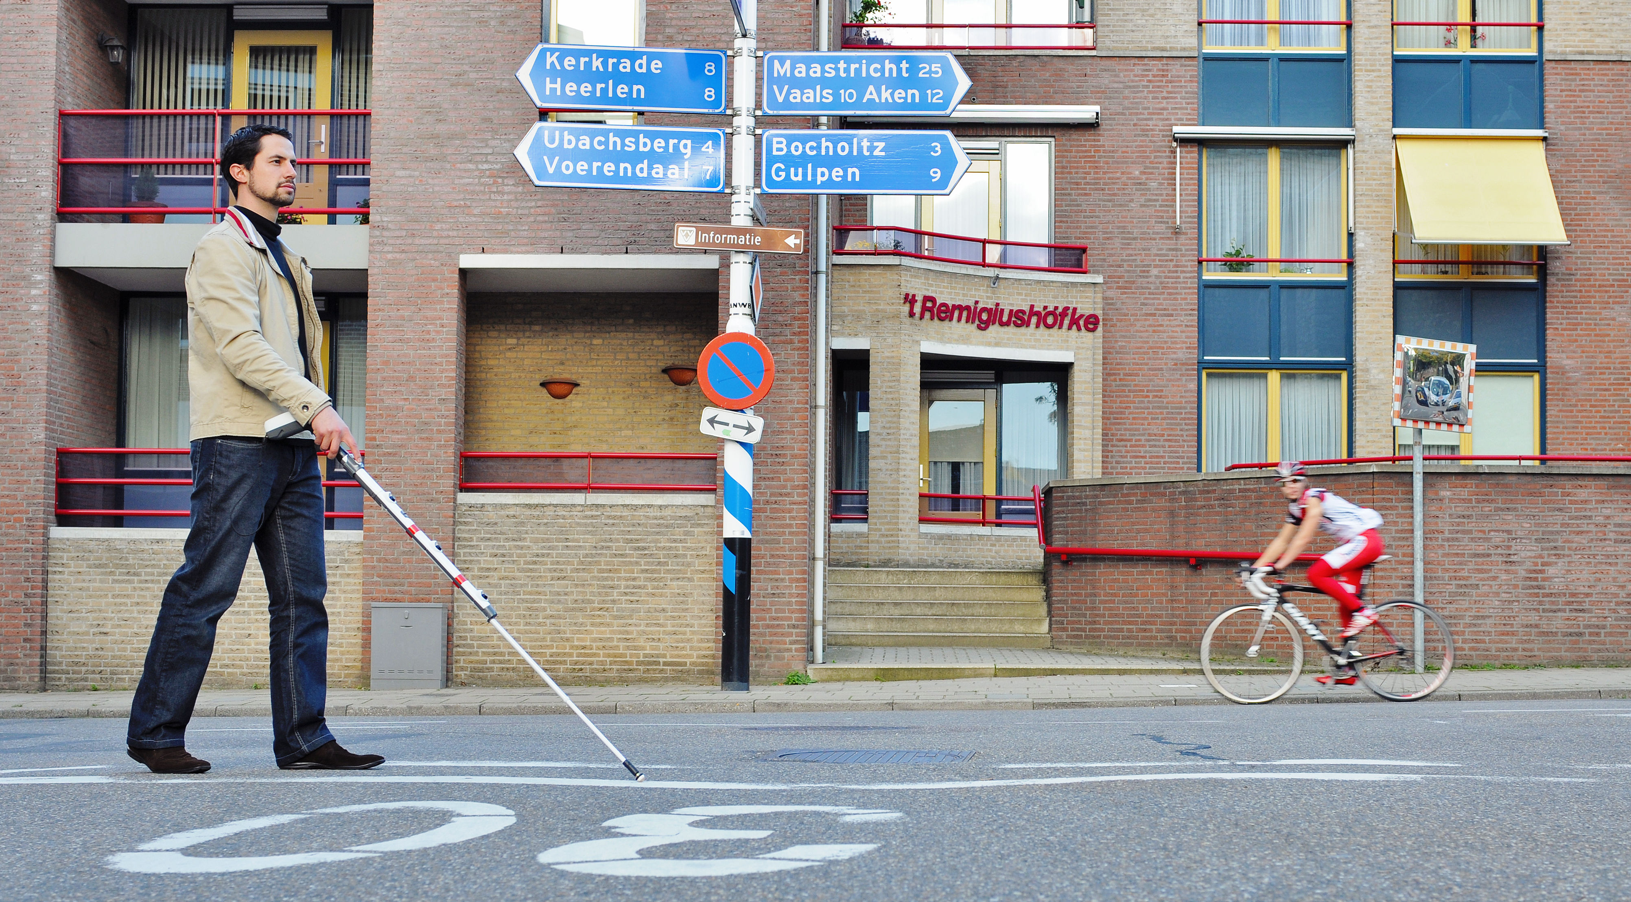
APPLICATIONS
This app helps kids improve their vocabulary and helps them think about all the things they see at their hands’ disposal
It helps visually-challenged people to understand things through the speech which comes out from the device
Has a high educational value and this app can be implemented as a futuristic learning way in schools and children will enjoy the practicality involved in this type of learning

Slide 20
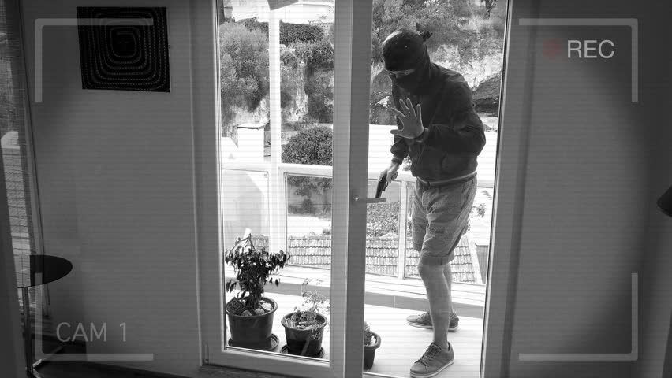
IMPROVEMENTS FOR OUR APP
This app can be integrated for security purposes in homes at the lowest cost possible
As of now, the app kind of struggles to differentiate between two similarly-structured objects placed close to each other which will be done in the future

Slide 21
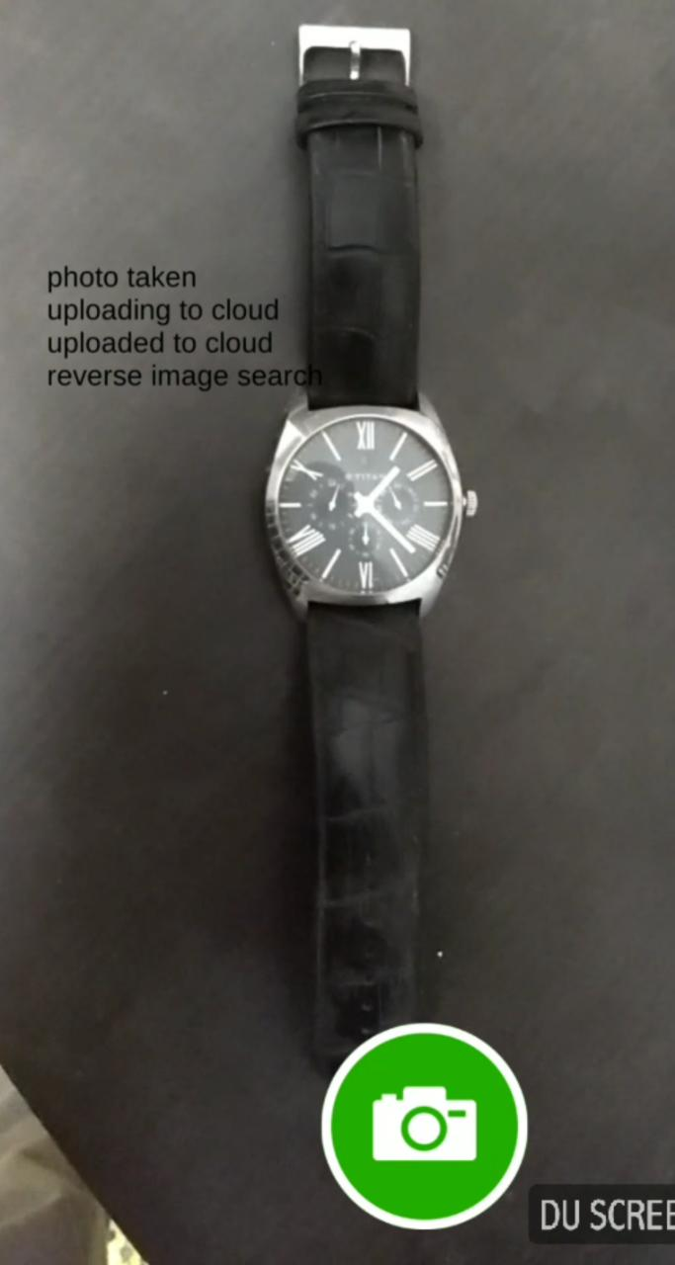
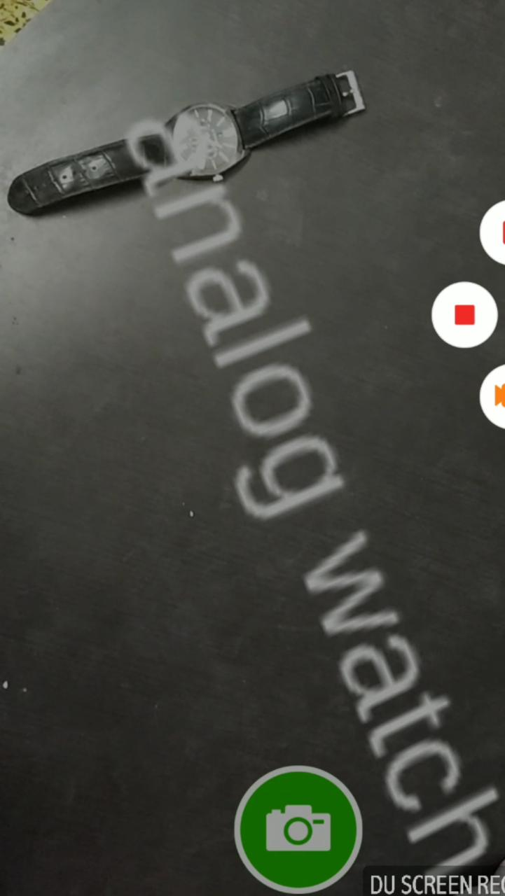
SCREENSHOTS
CAPTURING IMAGE
GUESS

Slide 22
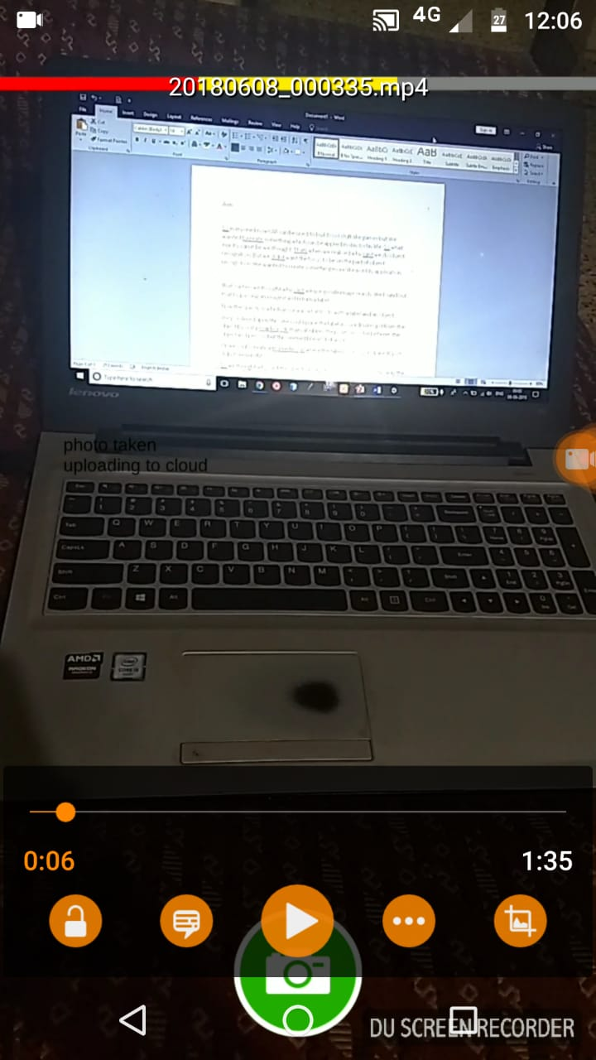
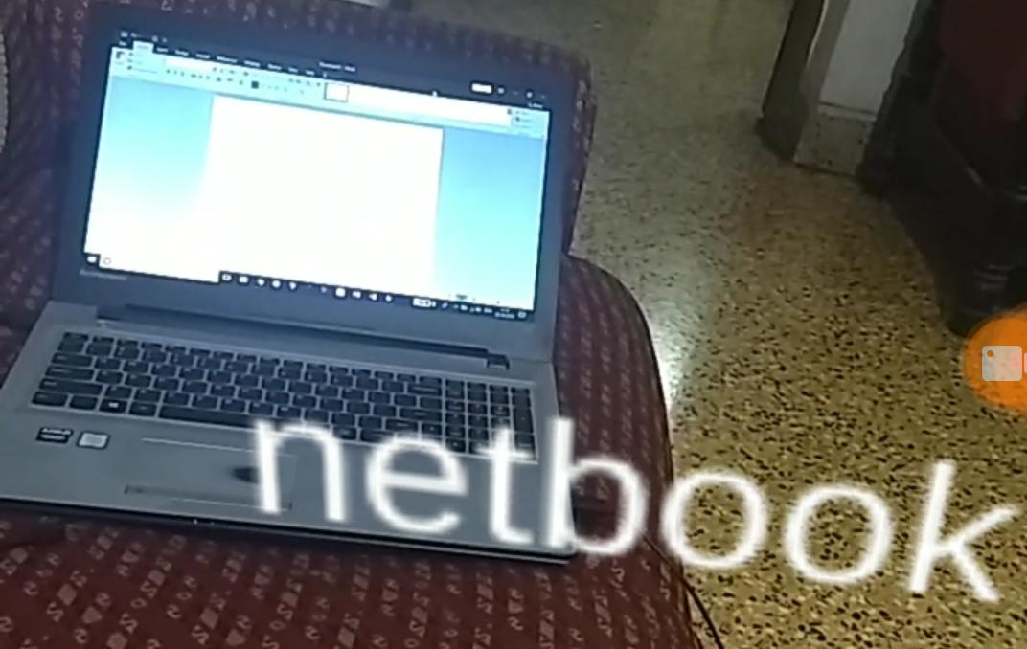
CAPTURING IMAGE
GUESS

Slide 23
Thank You !

